Slide 1
Charts in Tableau
-Ashu Mehta
Database Systems

Slide 2
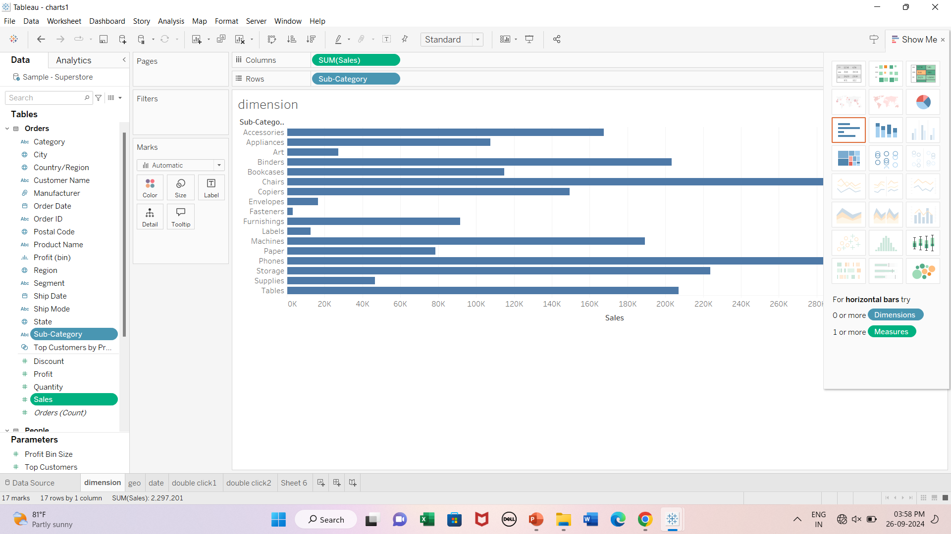
Dimension Field

Slide 3
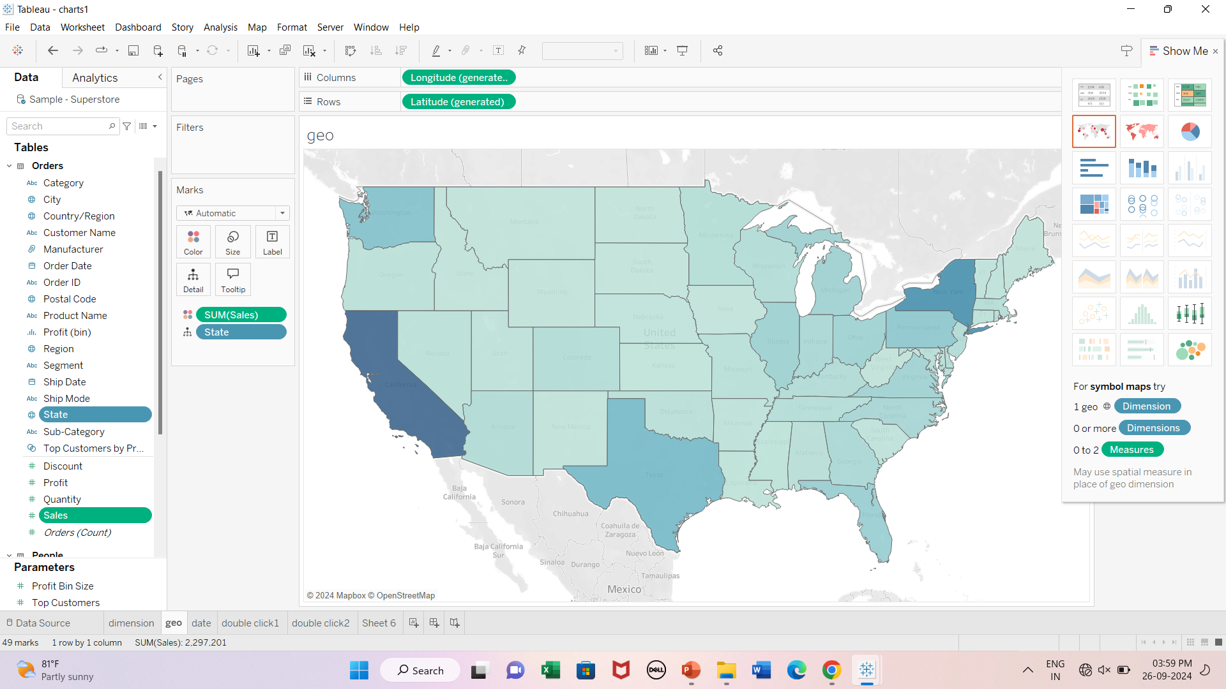
Geographical Field

Slide 4
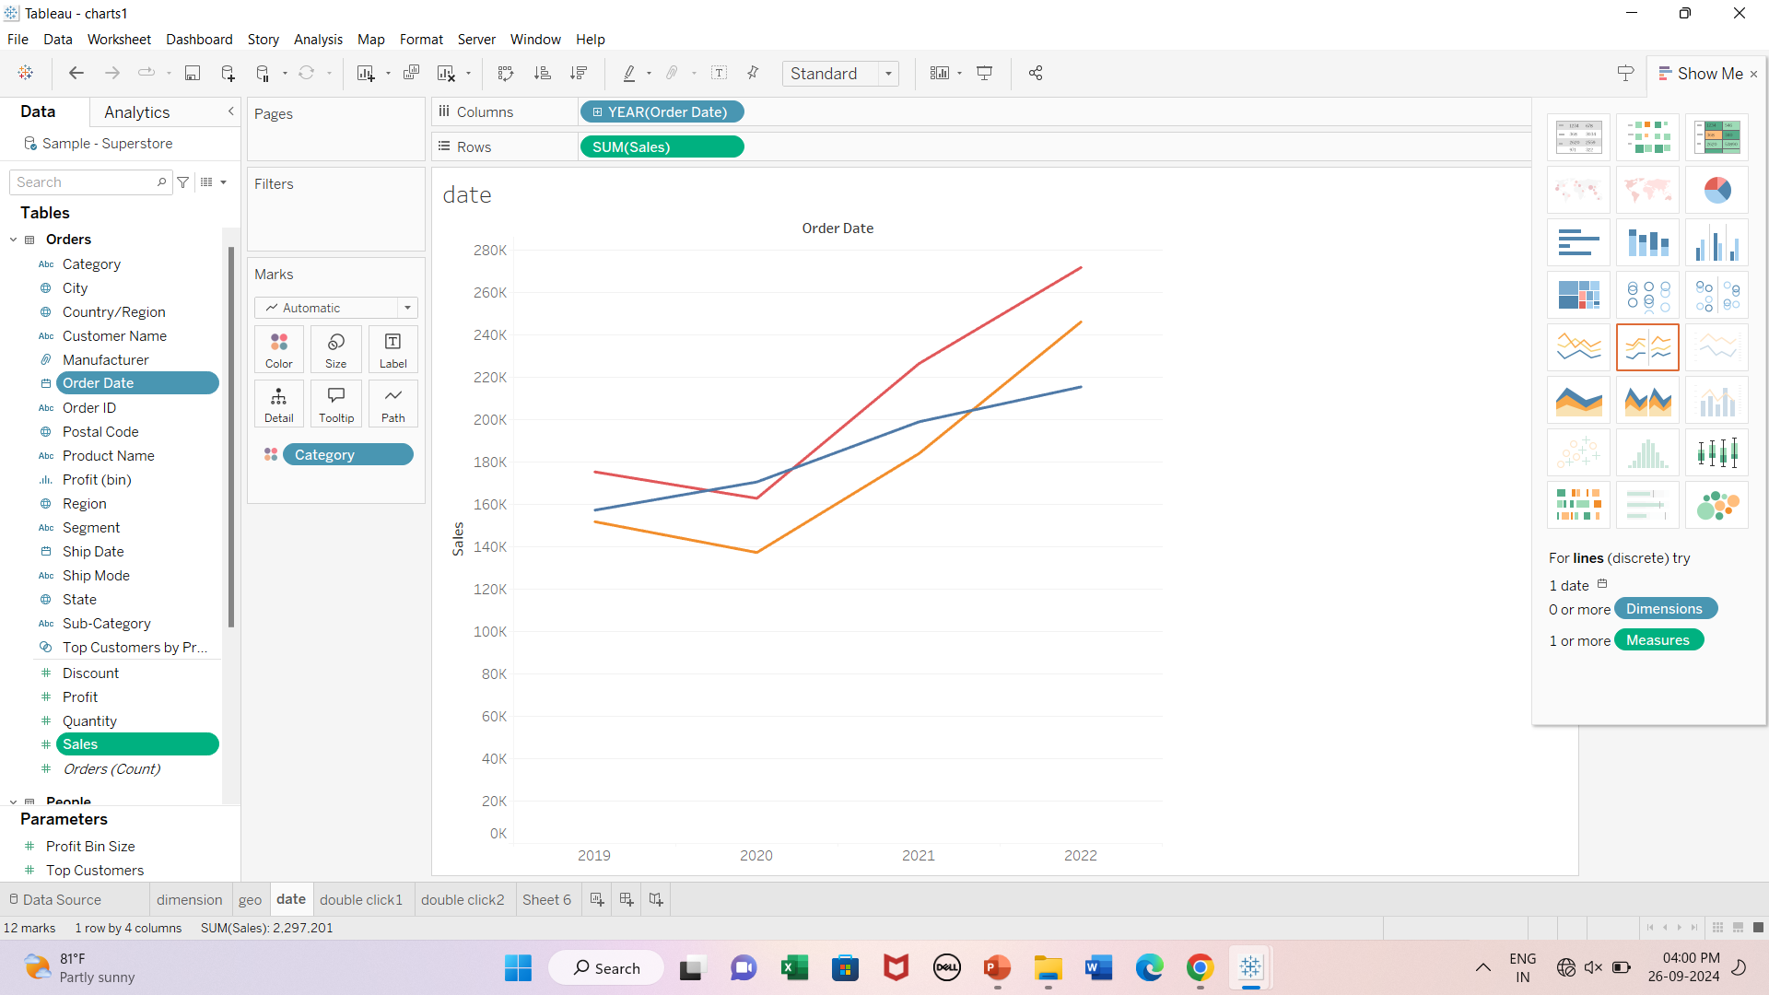
Date Field

Slide 5
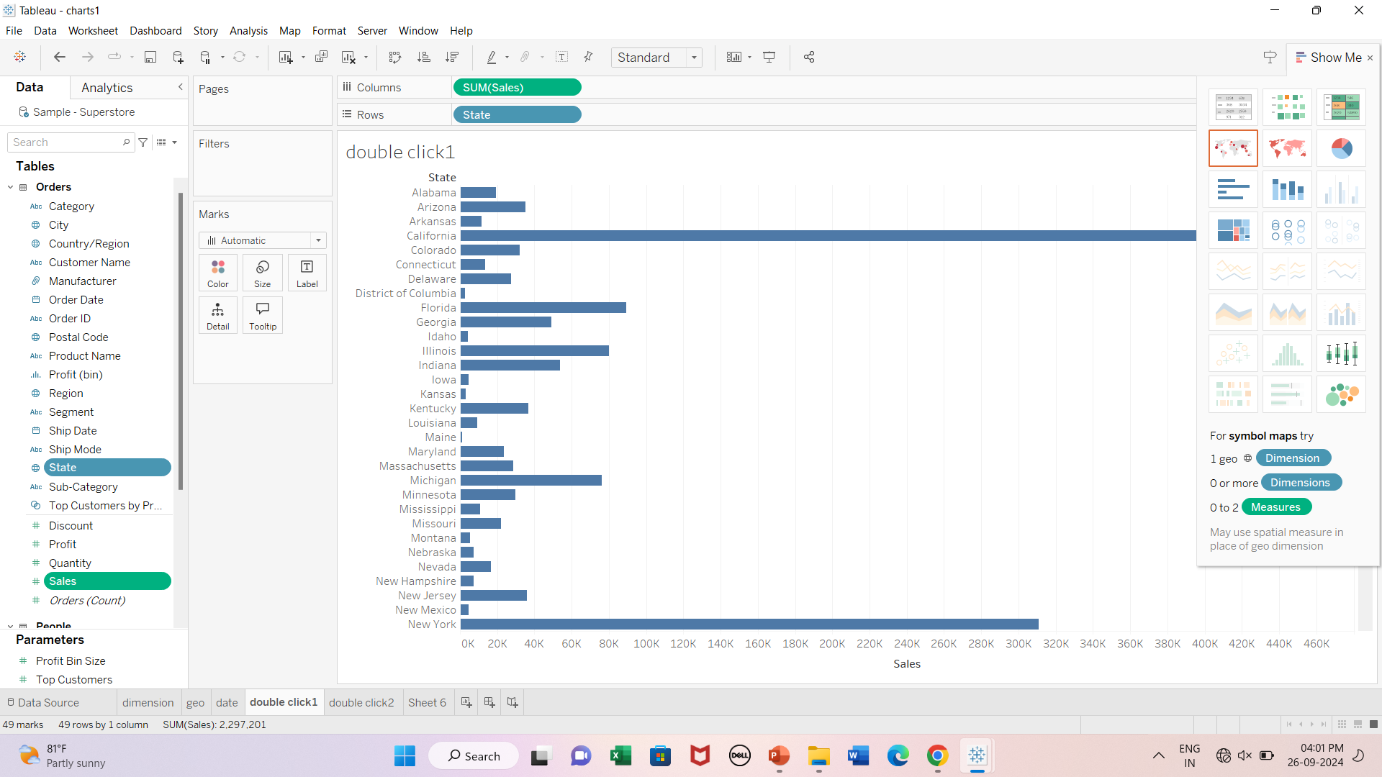
Double click measure and then dimension

Slide 6
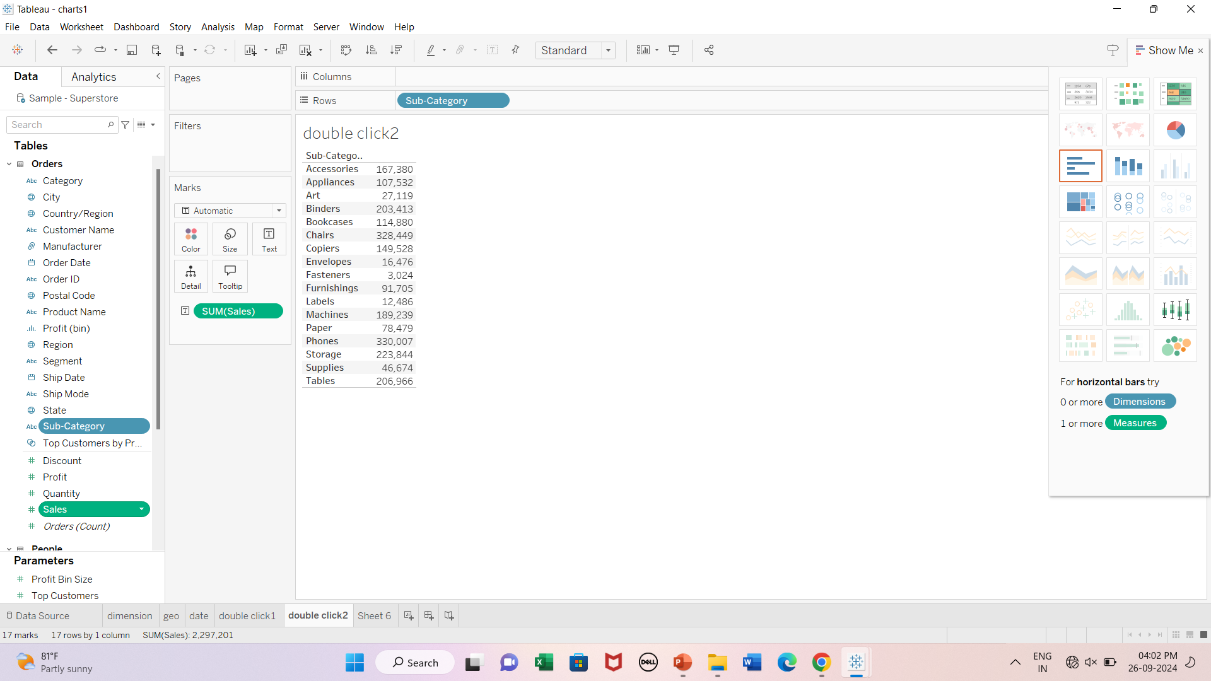
Double click dimension and then measure

Slide 7
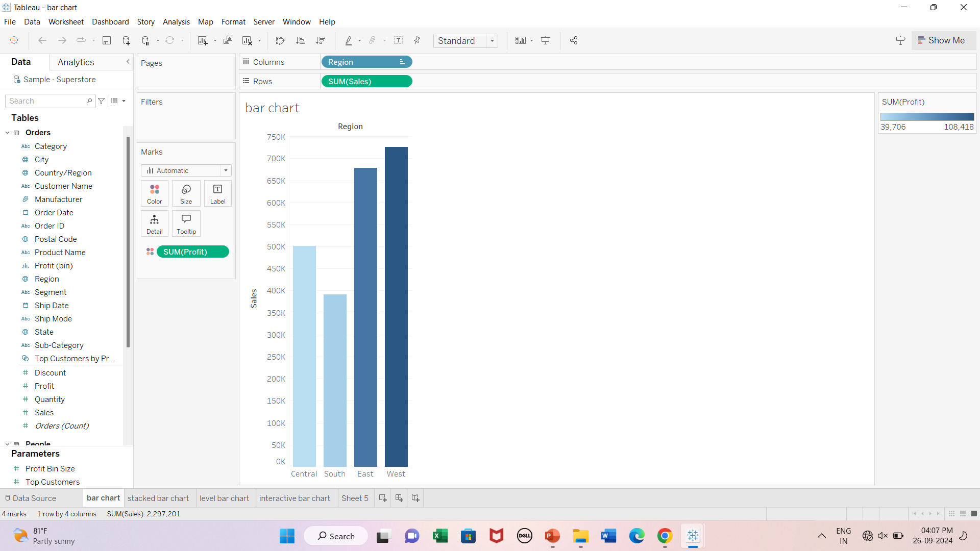
Bar Chart

Slide 8
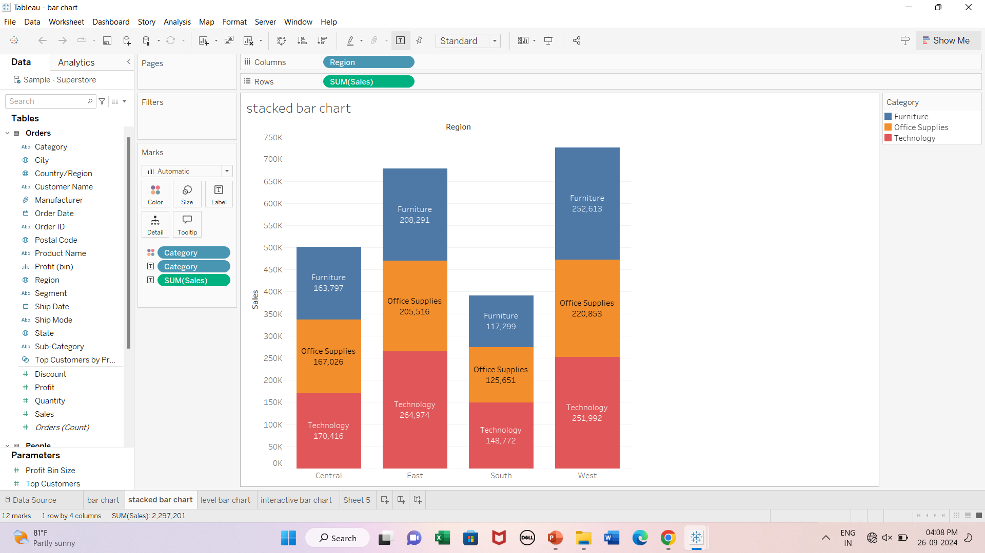
Stacked Bar chart

Slide 9
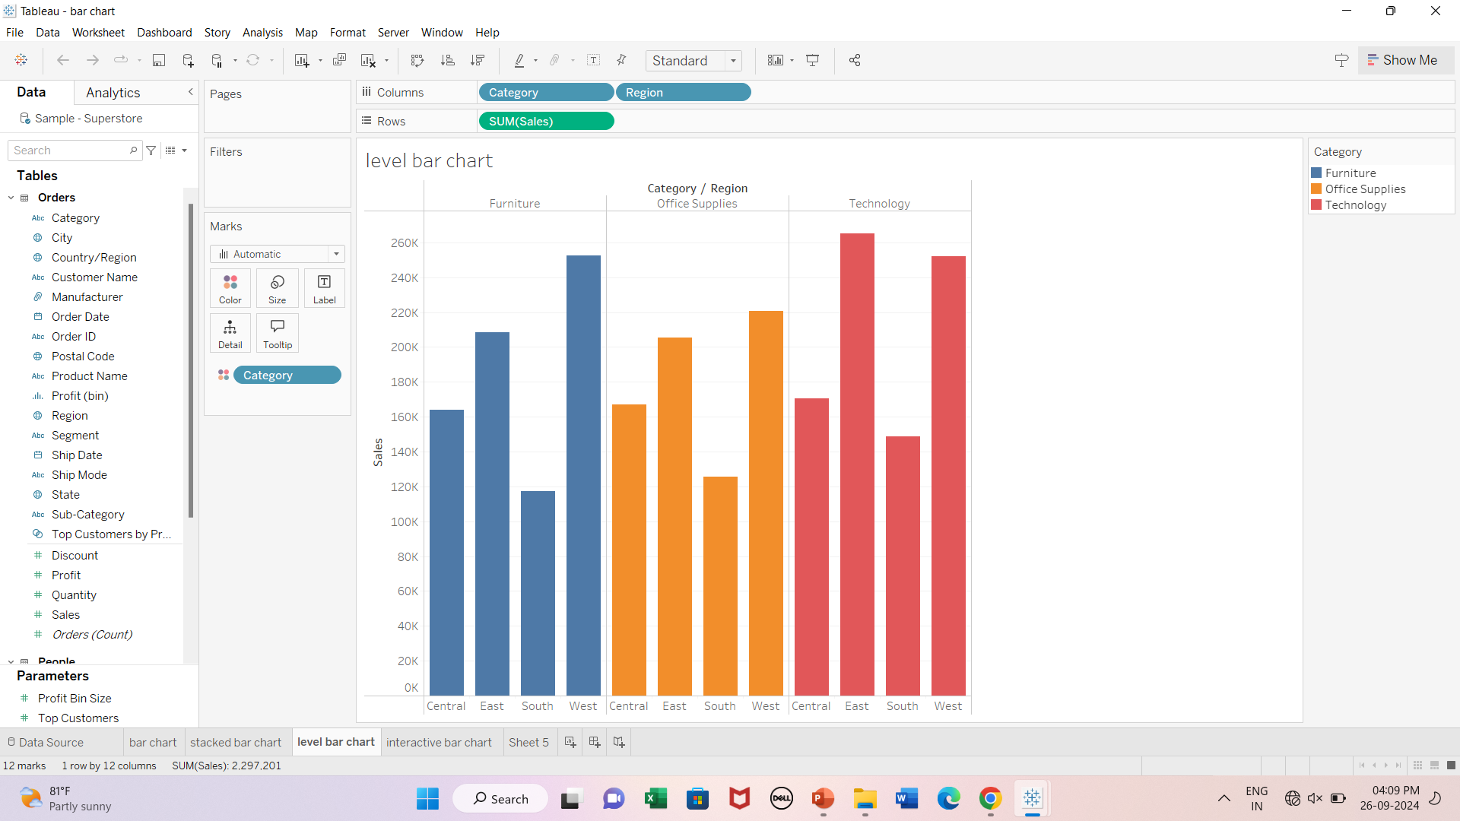
Level Bar Chart

Slide 10
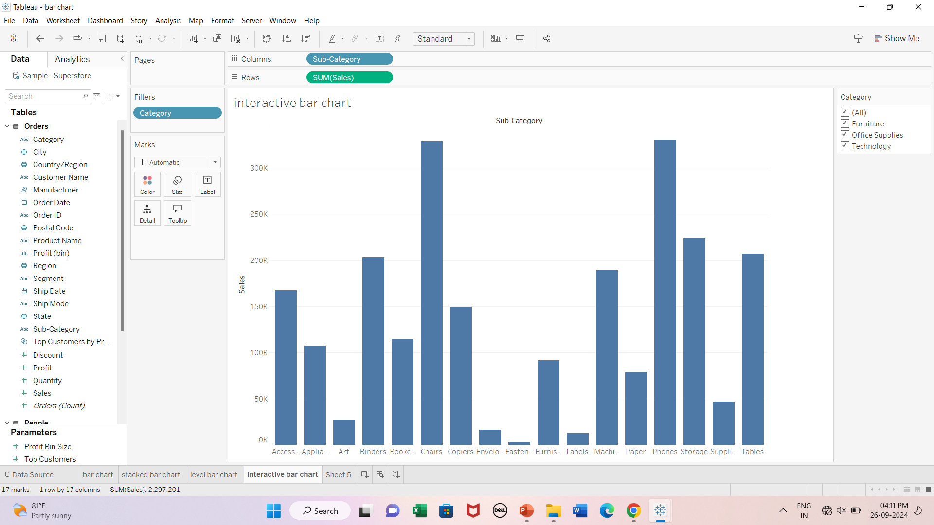
Interactive Bar chart

Slide 11
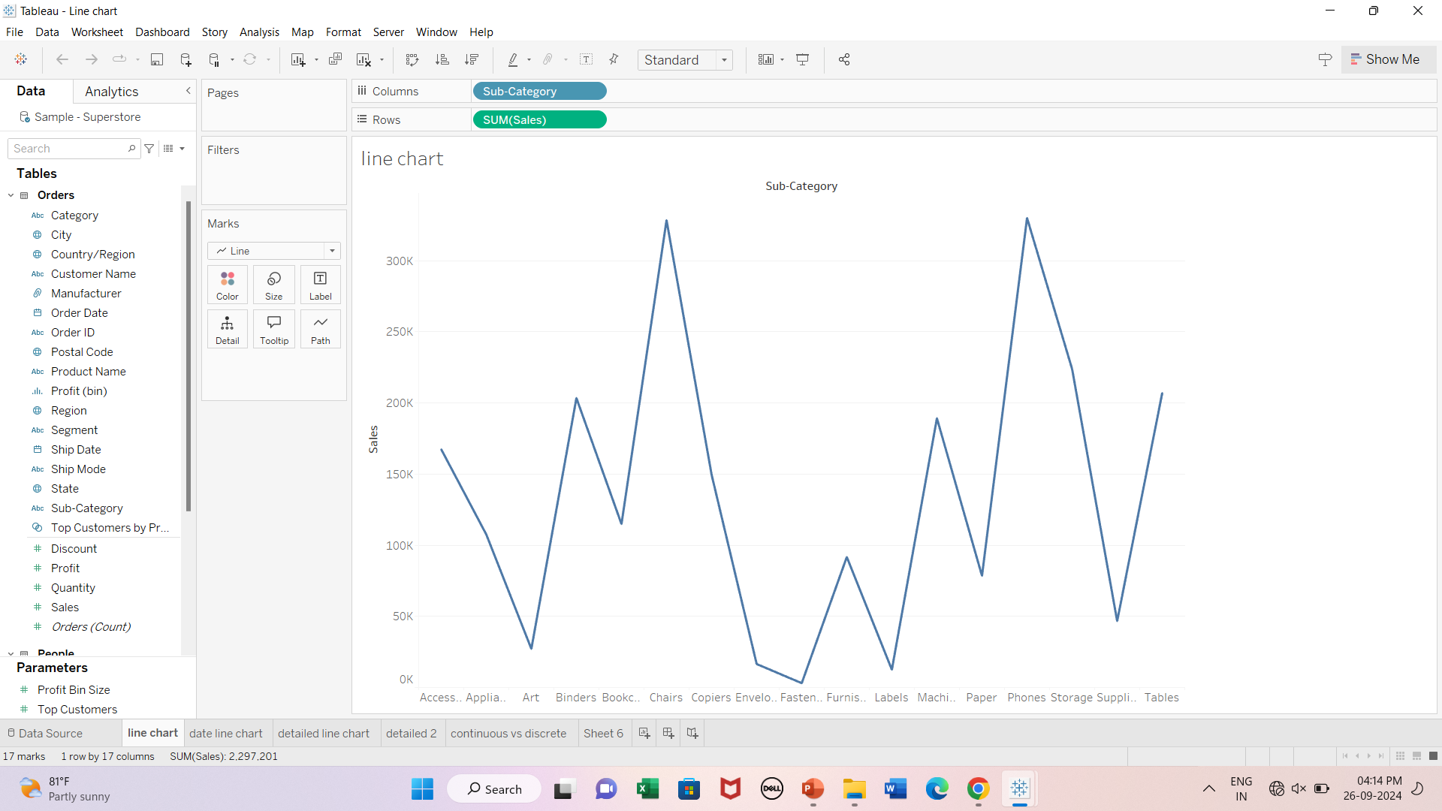
Line Chart

Slide 12
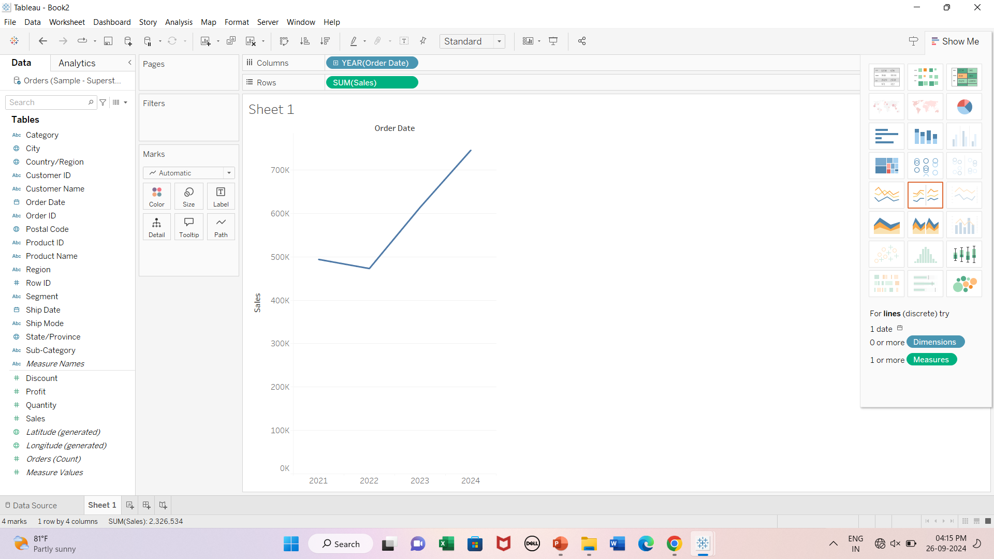
Line chart- Date Field

Slide 13
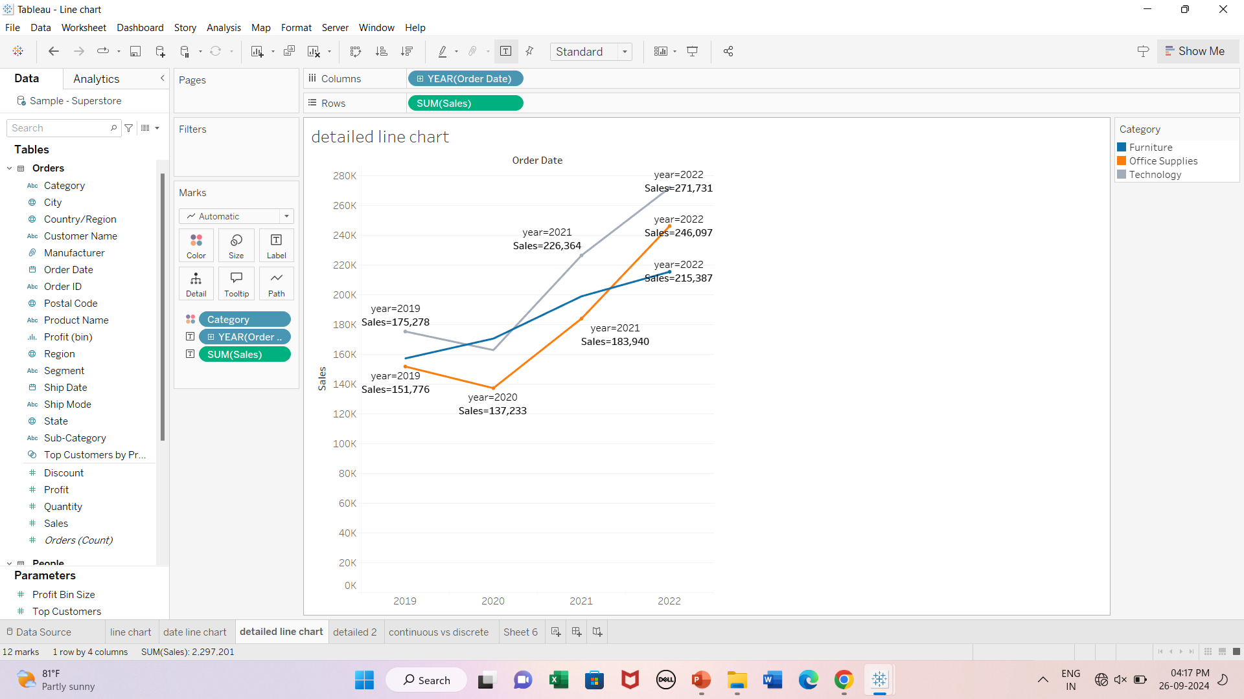
Detailed Line chart

Slide 14
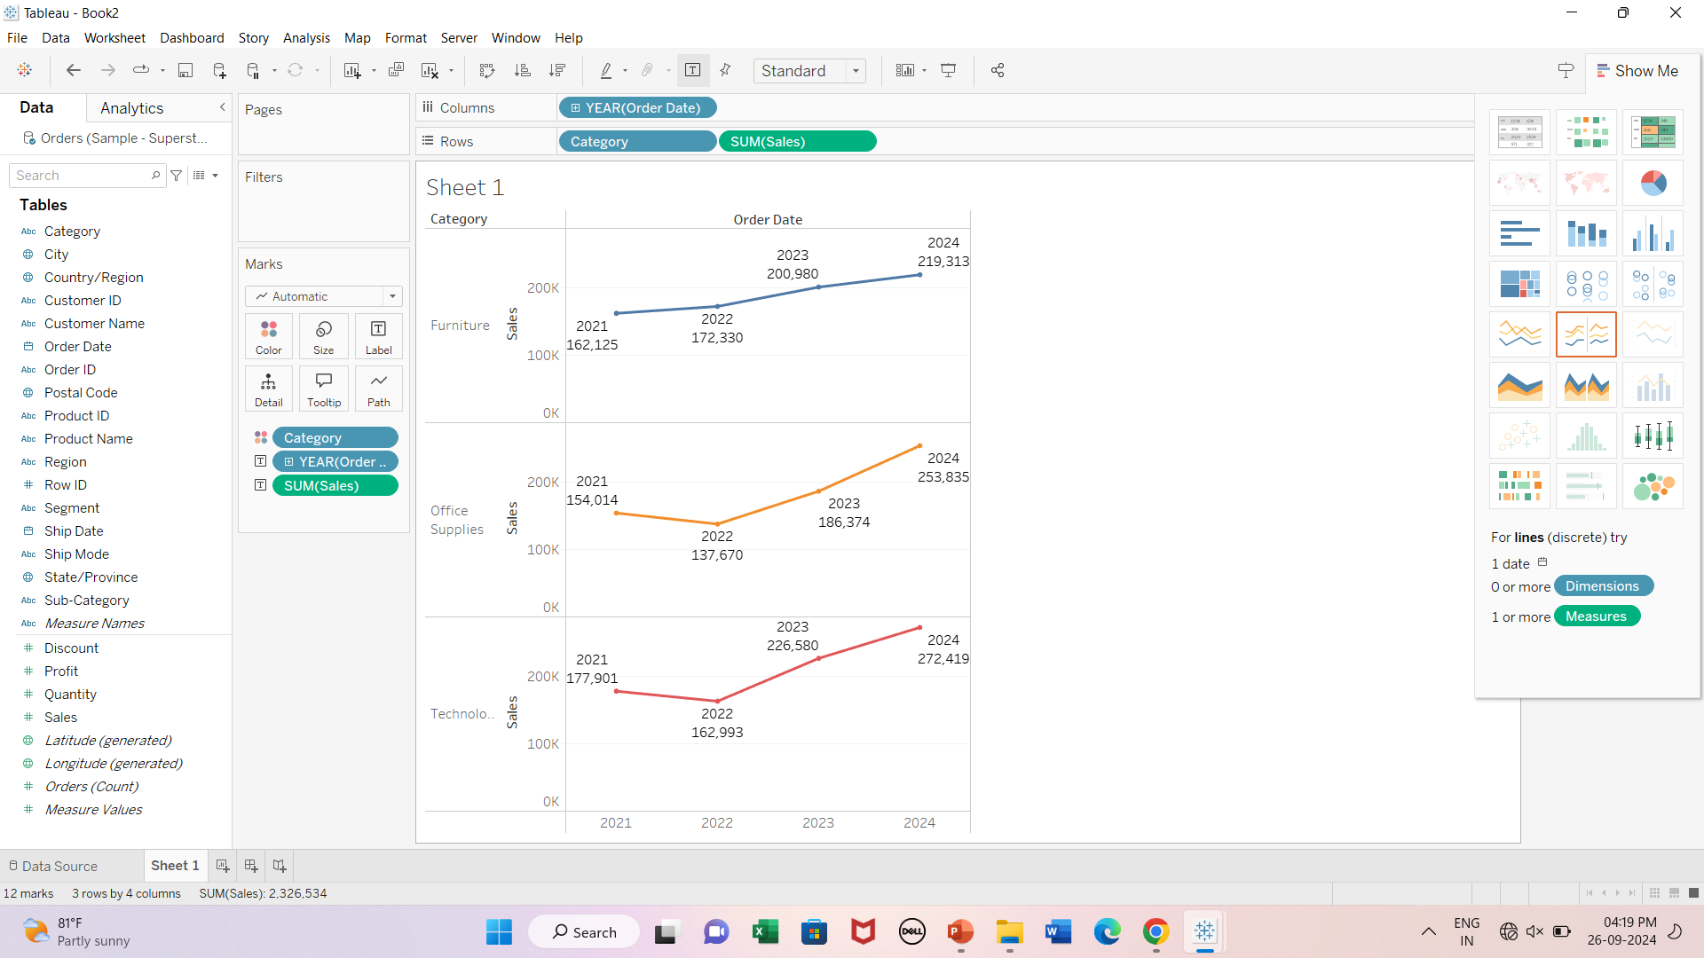
Detailed Line chart

Slide 15
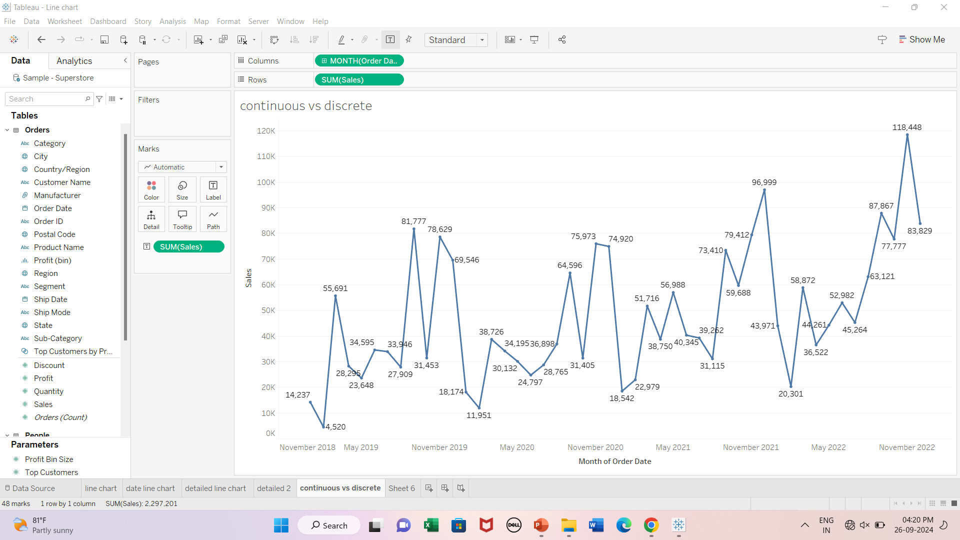
Discrete Vs Continuous Line chart

Slide 16
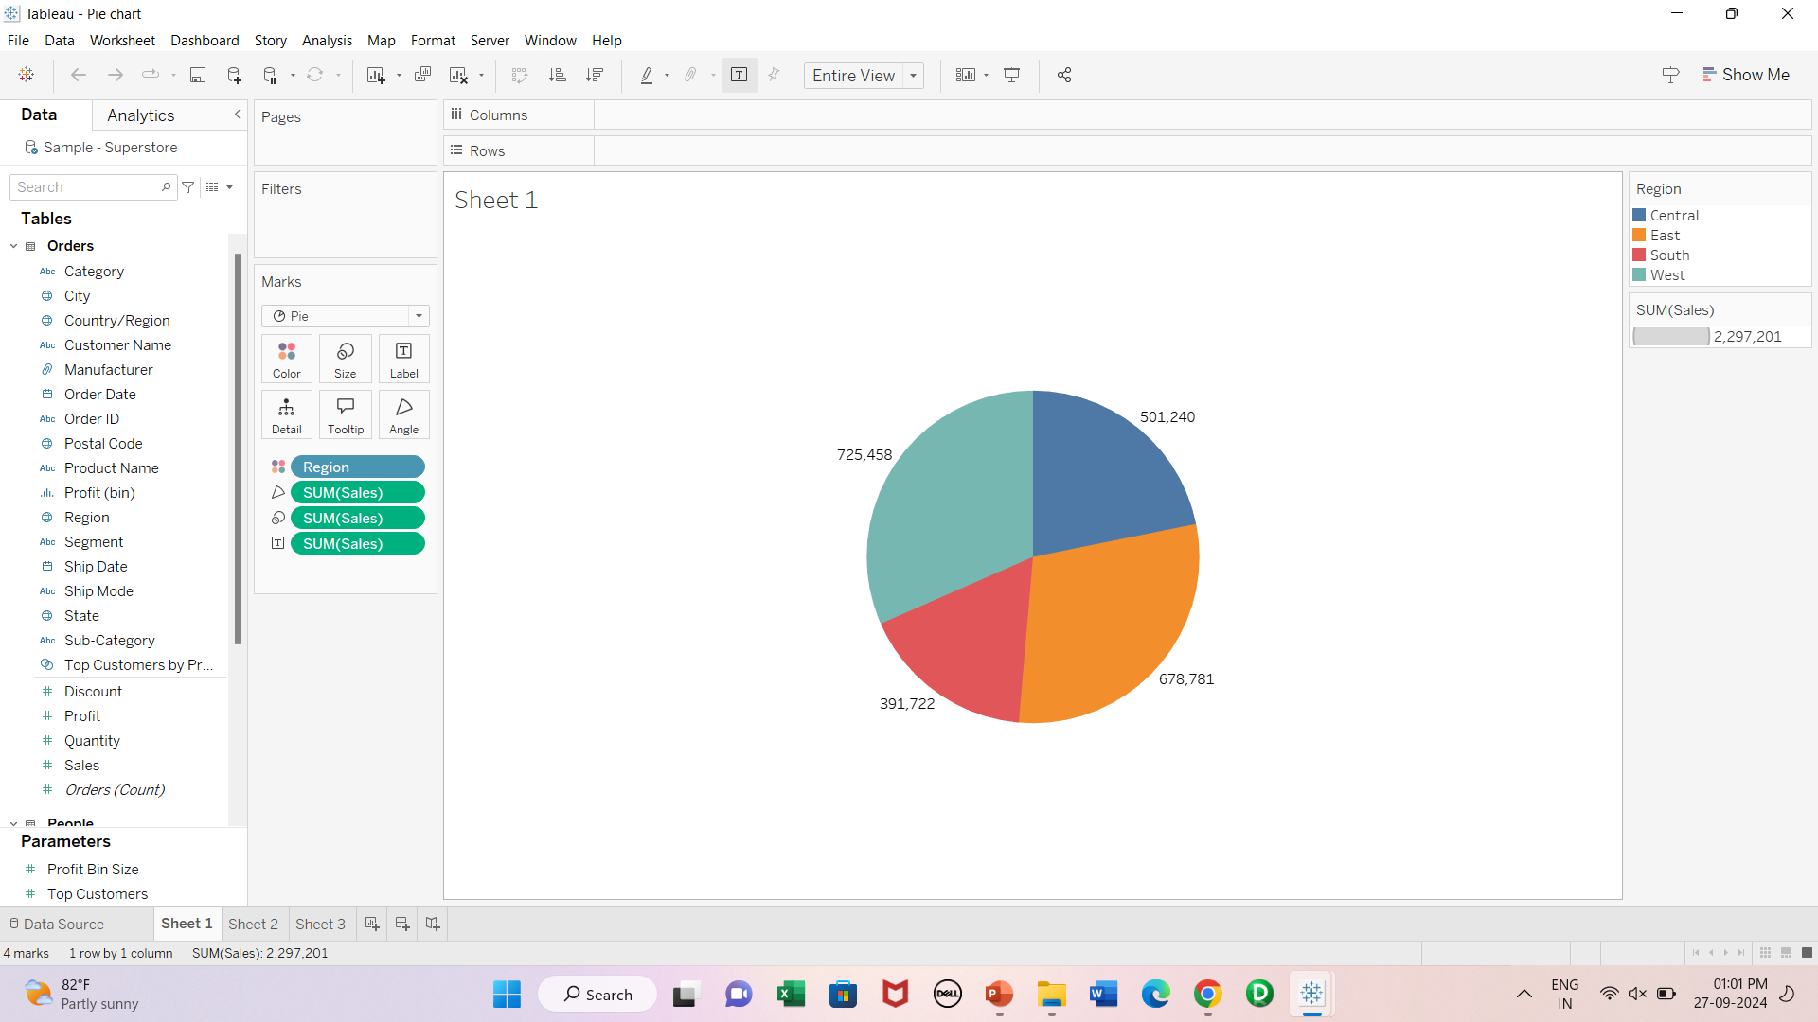
Pie Chart

Slide 17
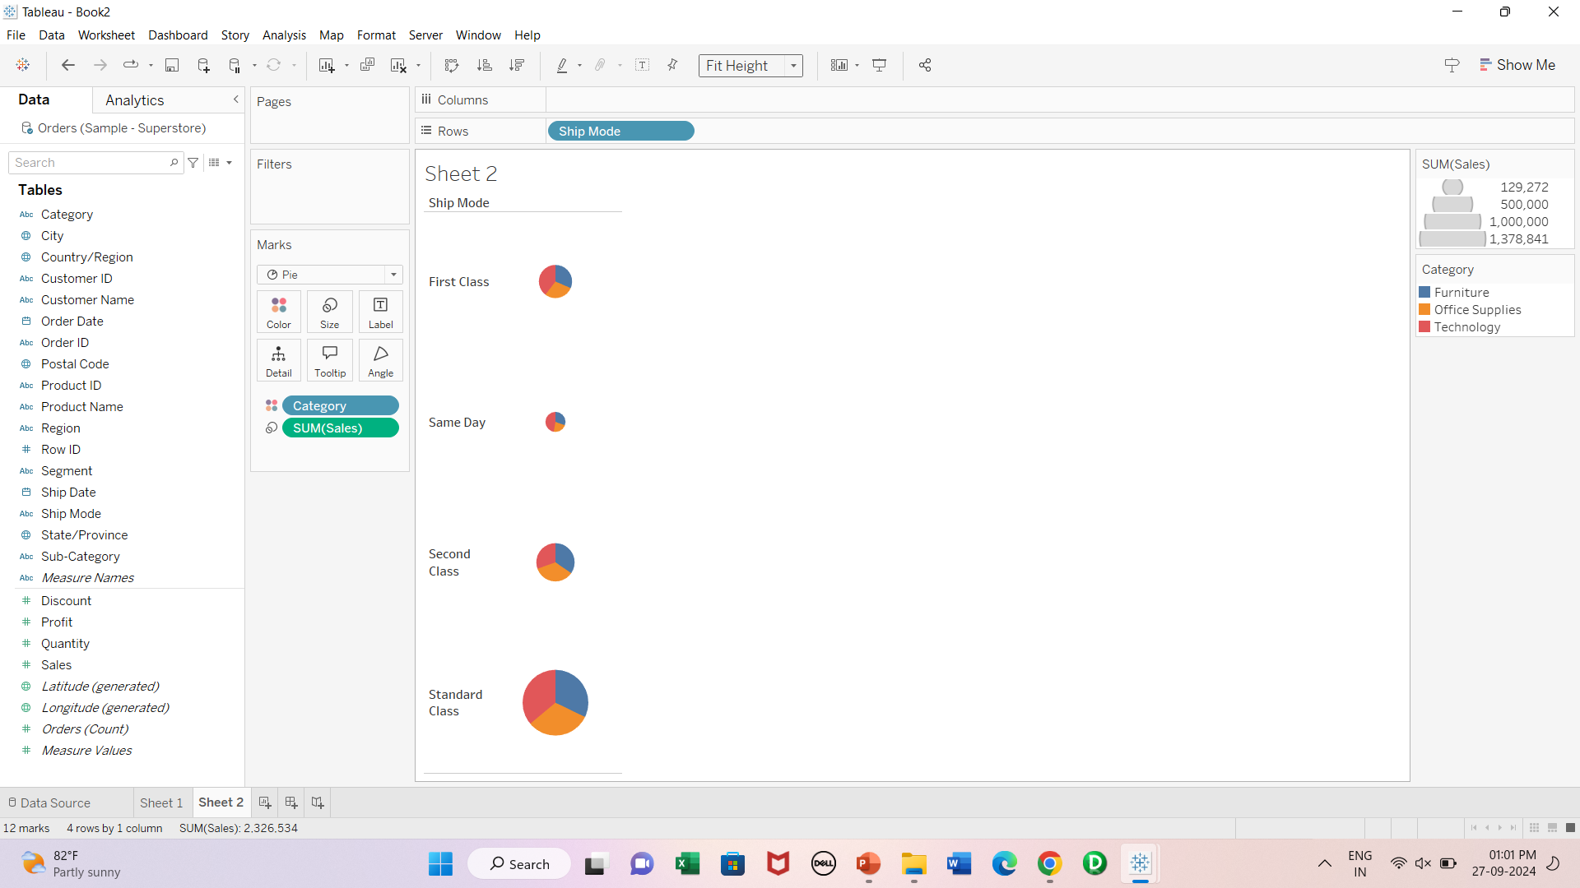
Pie Chart

Slide 18
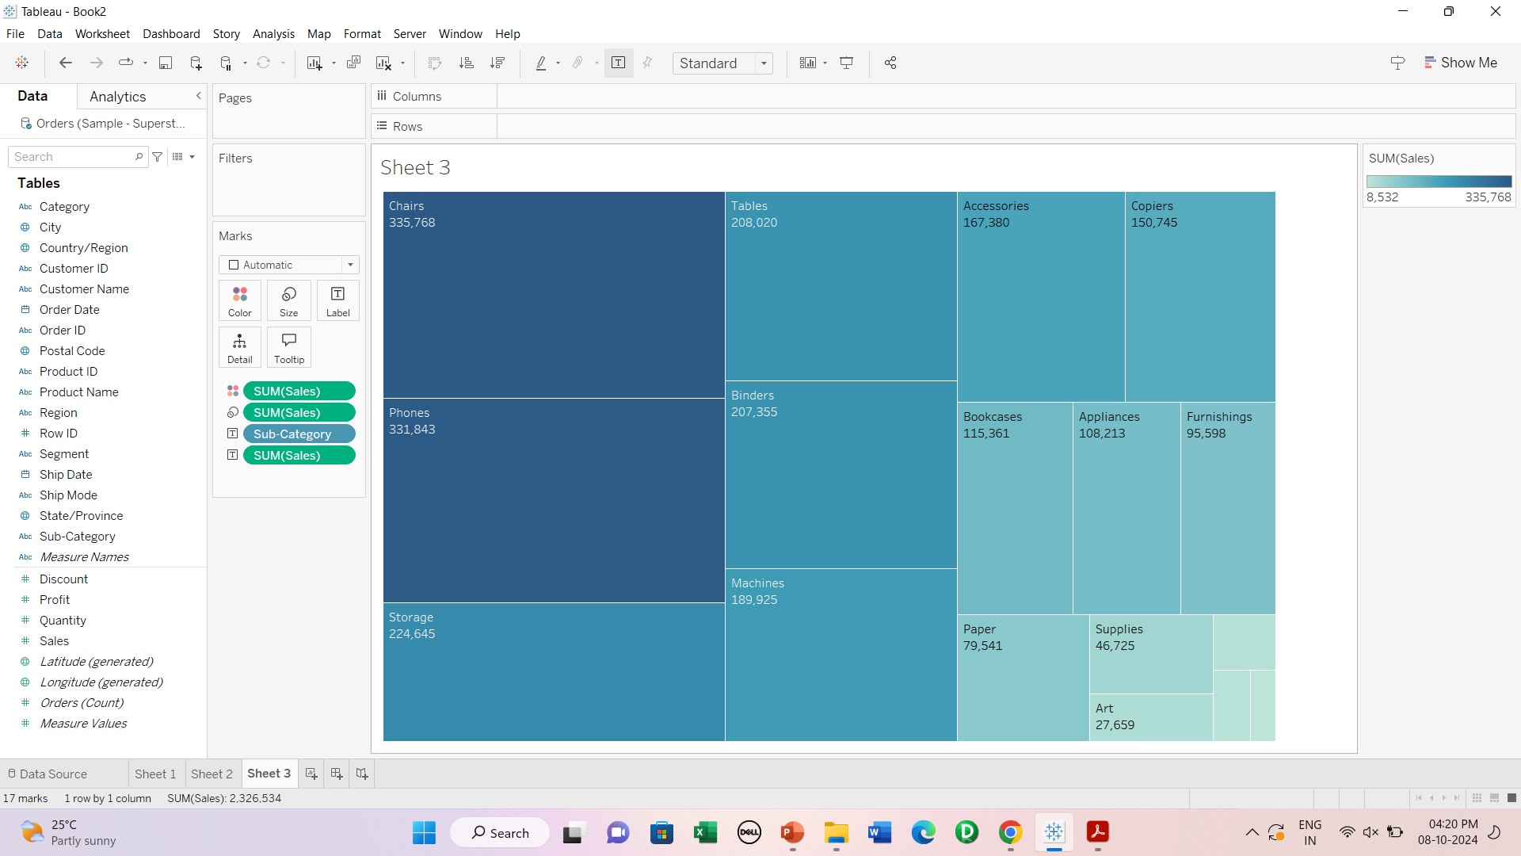
Tree Map

Slide 19
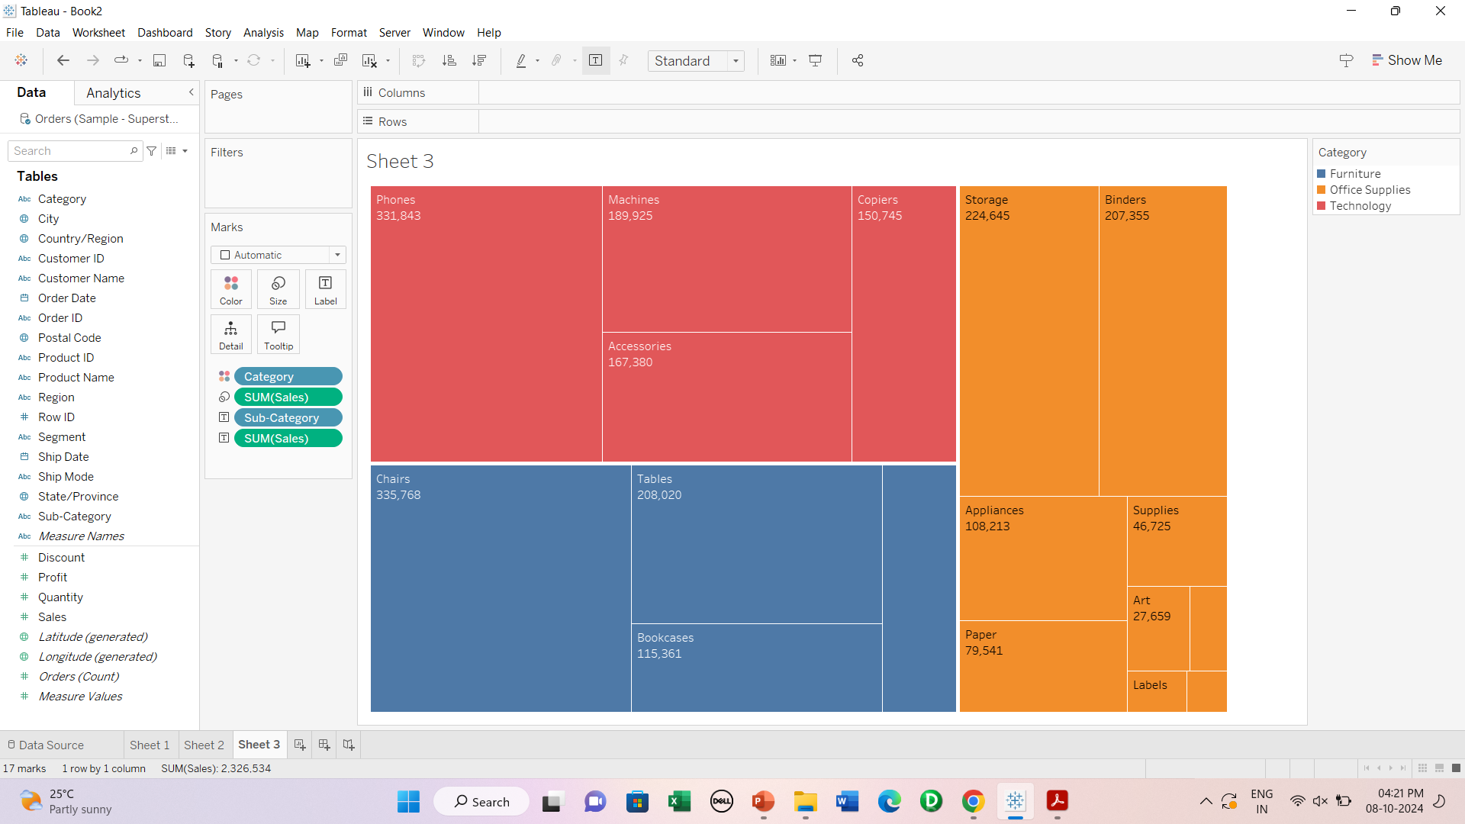
Coloured Tree Map

Slide 20
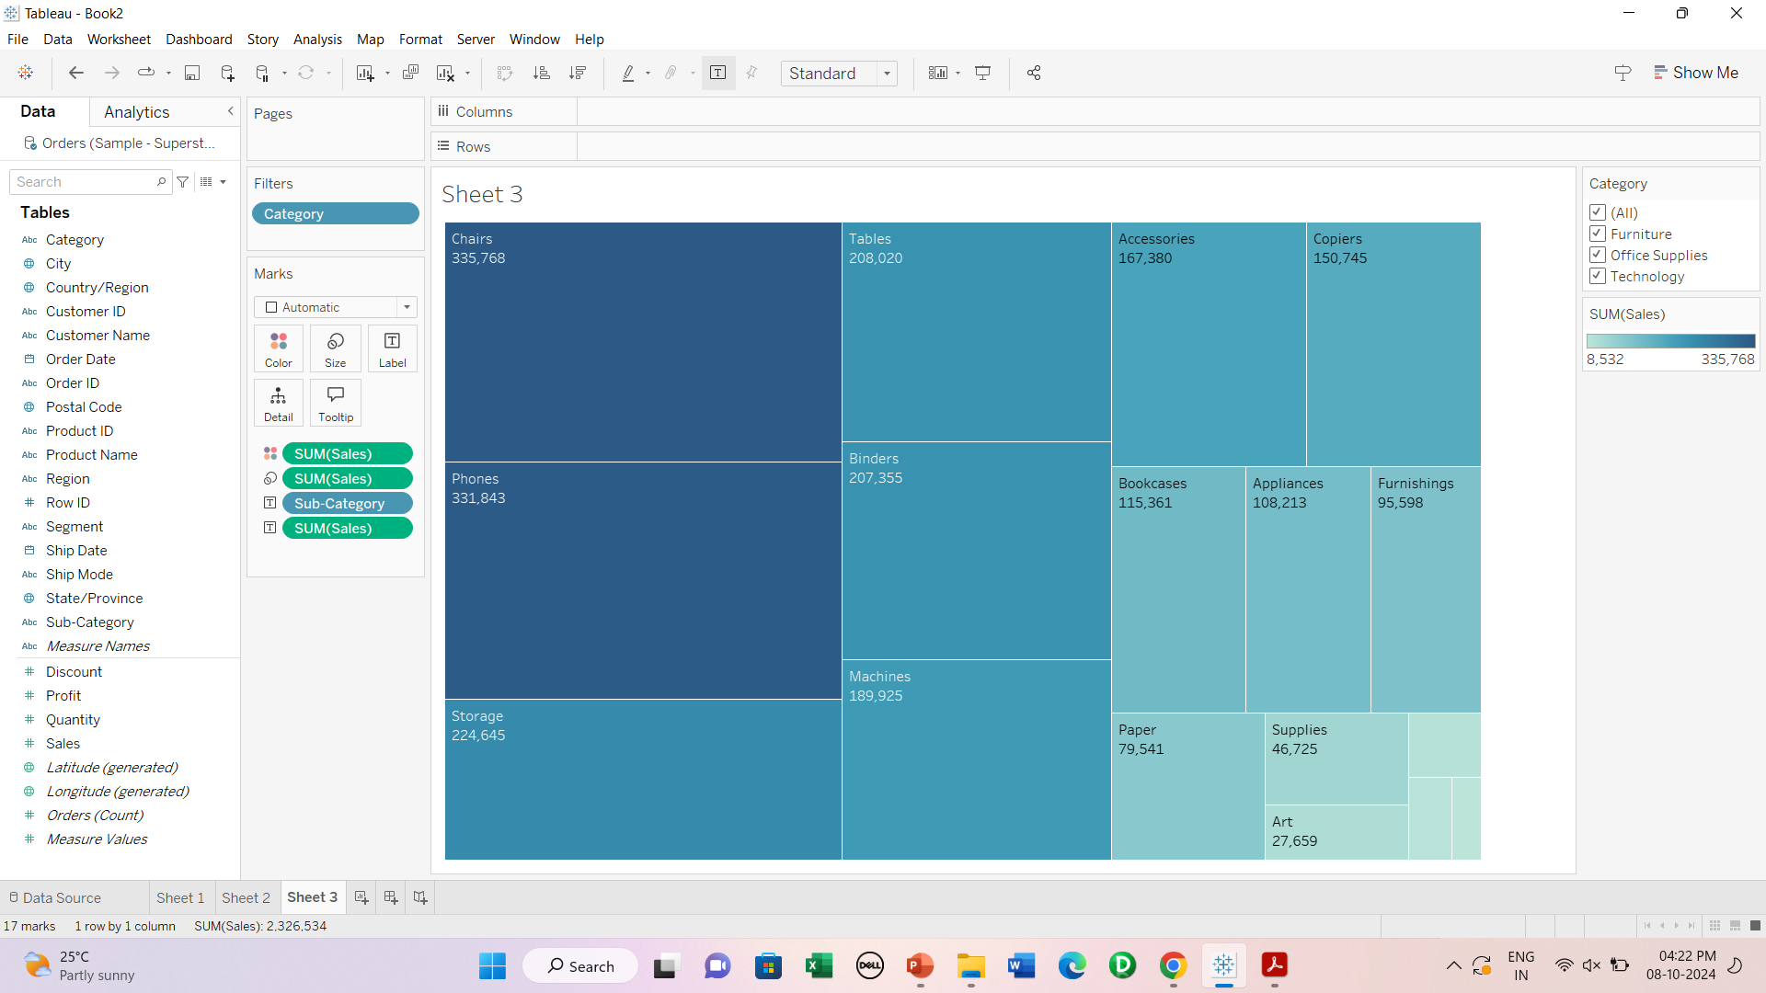
Interactive tree map

Slide 21
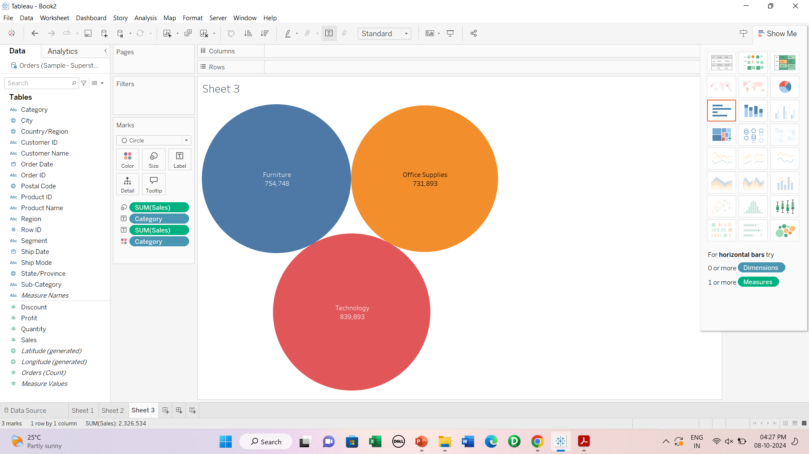
Bubble chart- default

Slide 22
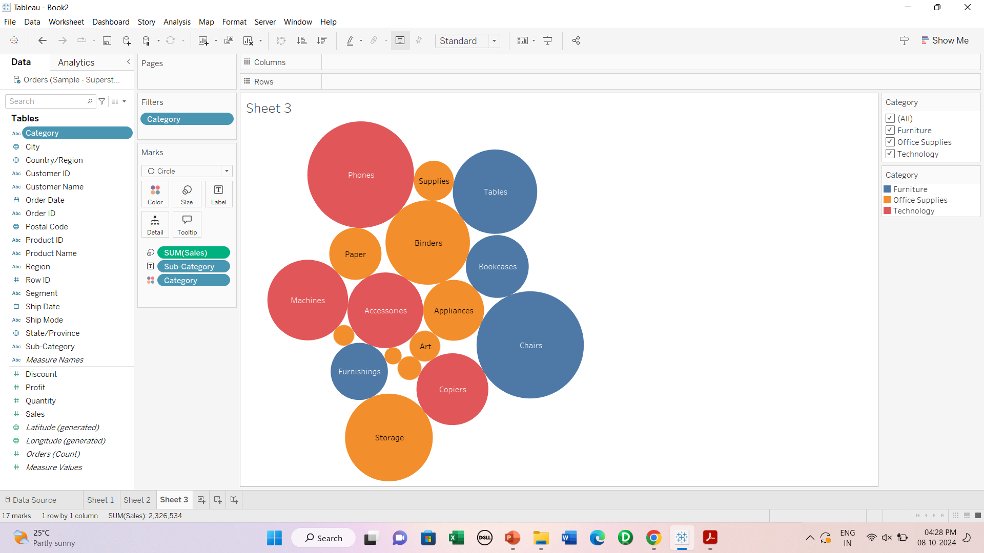
Bubble chart- Coloured & Interactive

Slide 23
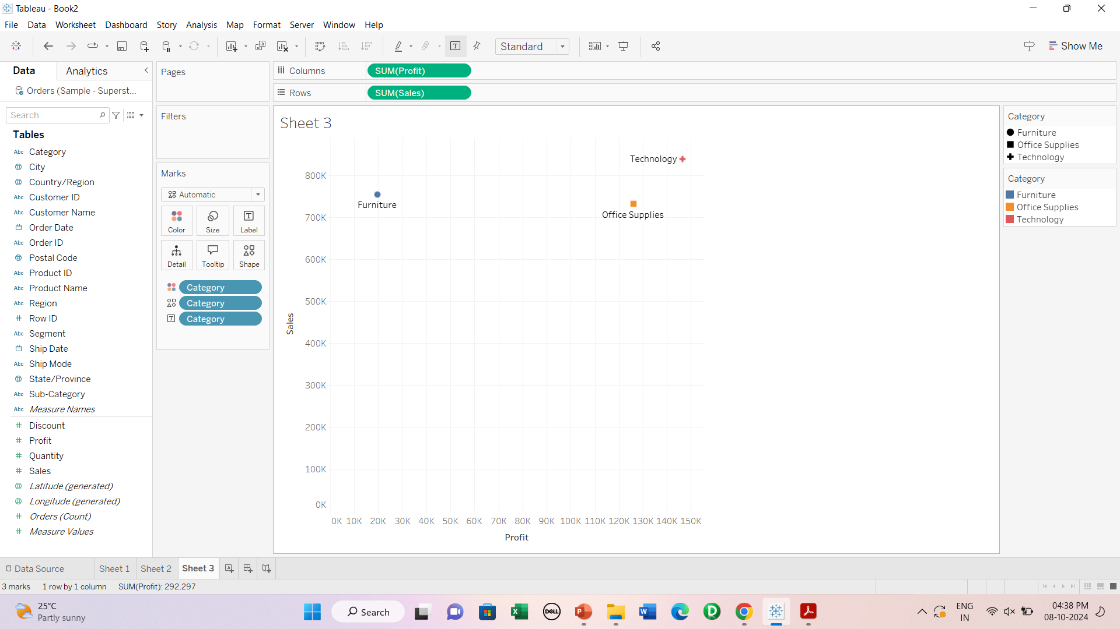
Scatter Chart

Slide 24
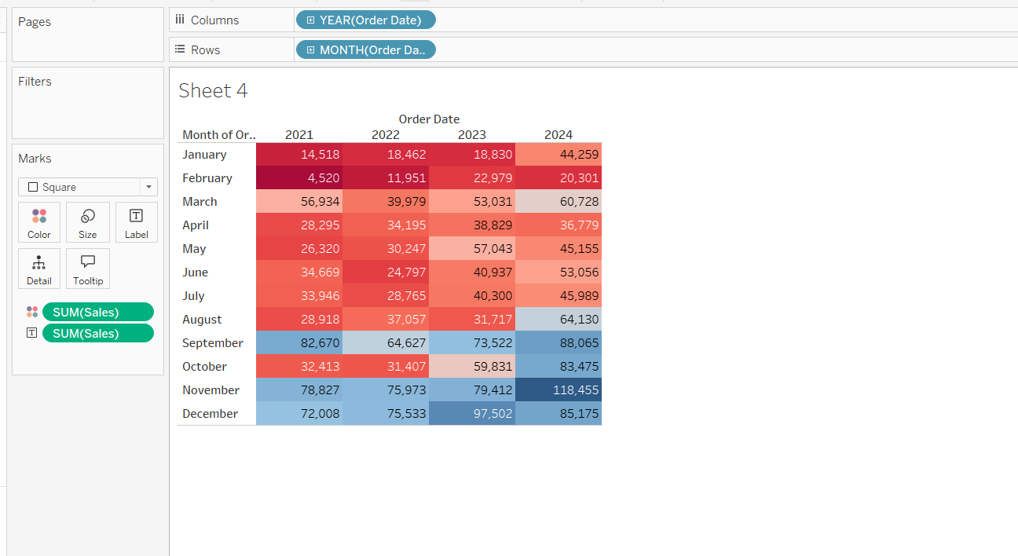
Heat Map

Slide 25
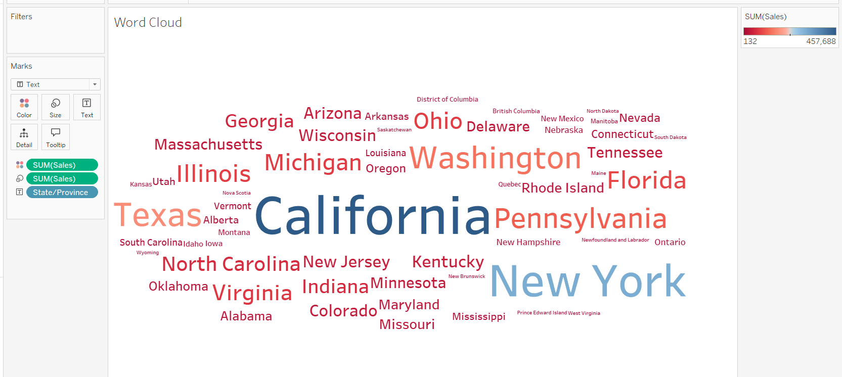
Word Cloud-1

Slide 26
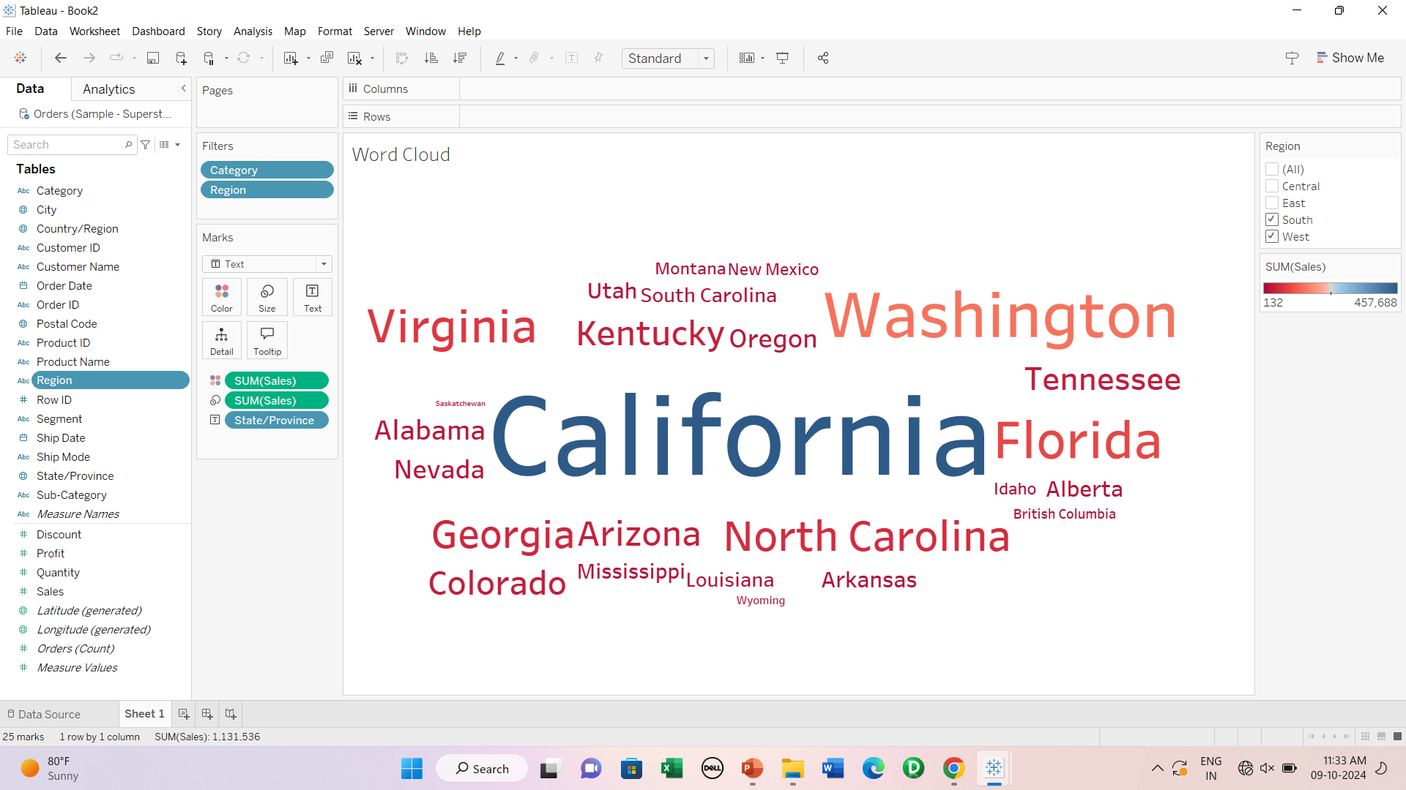
Word Cloud- Interactive

Slide 27
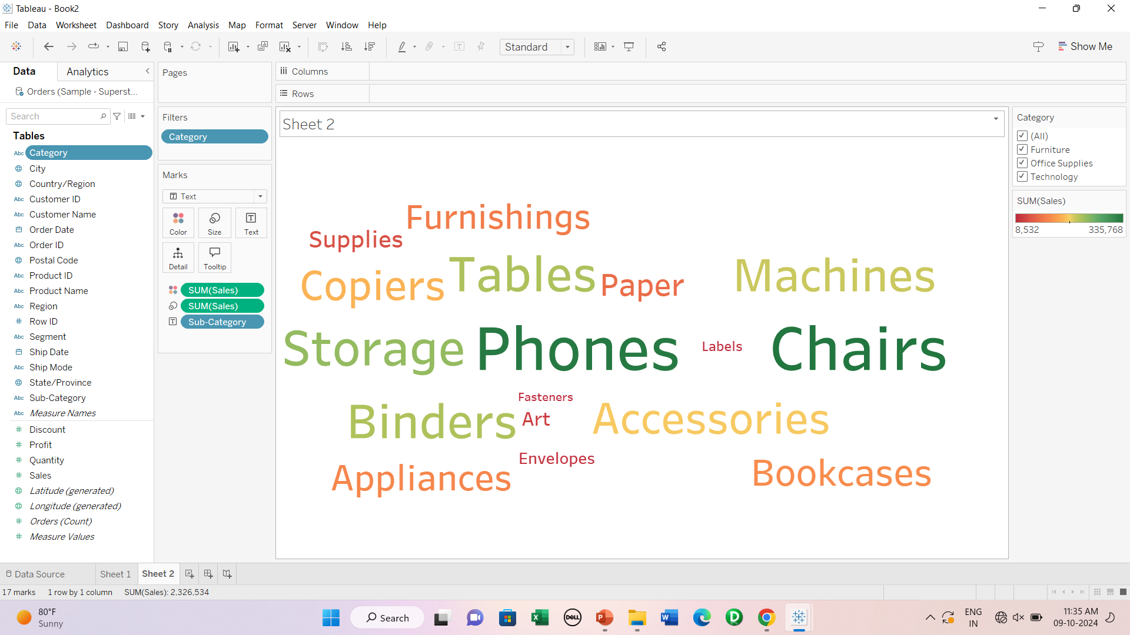
Word Cloud-2

Slide 28
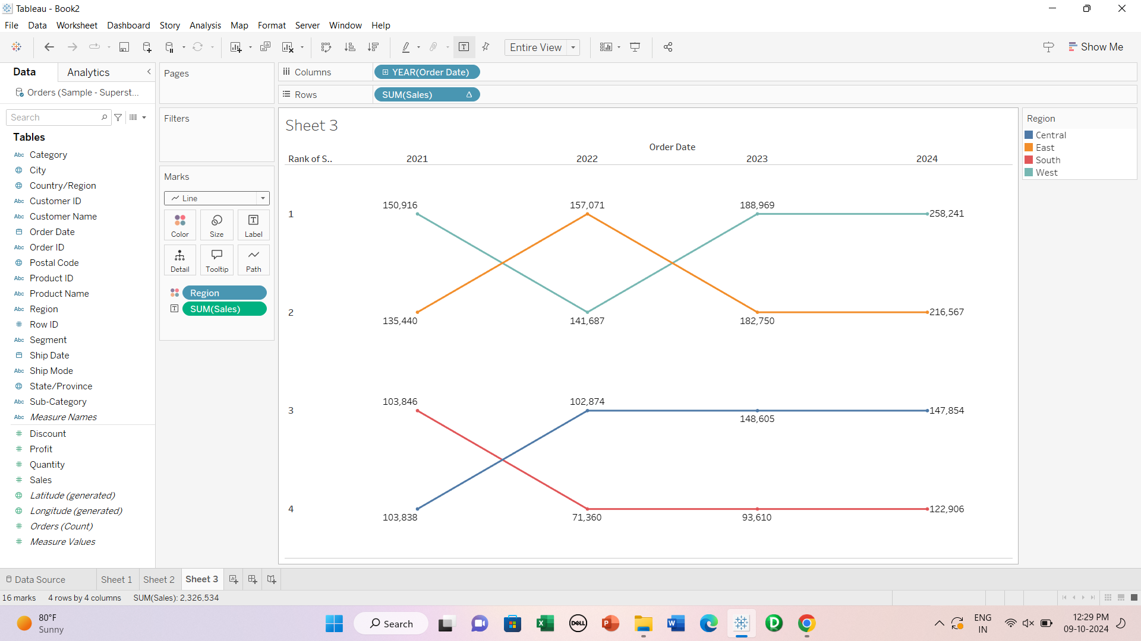
Bump Chart

Slide 29
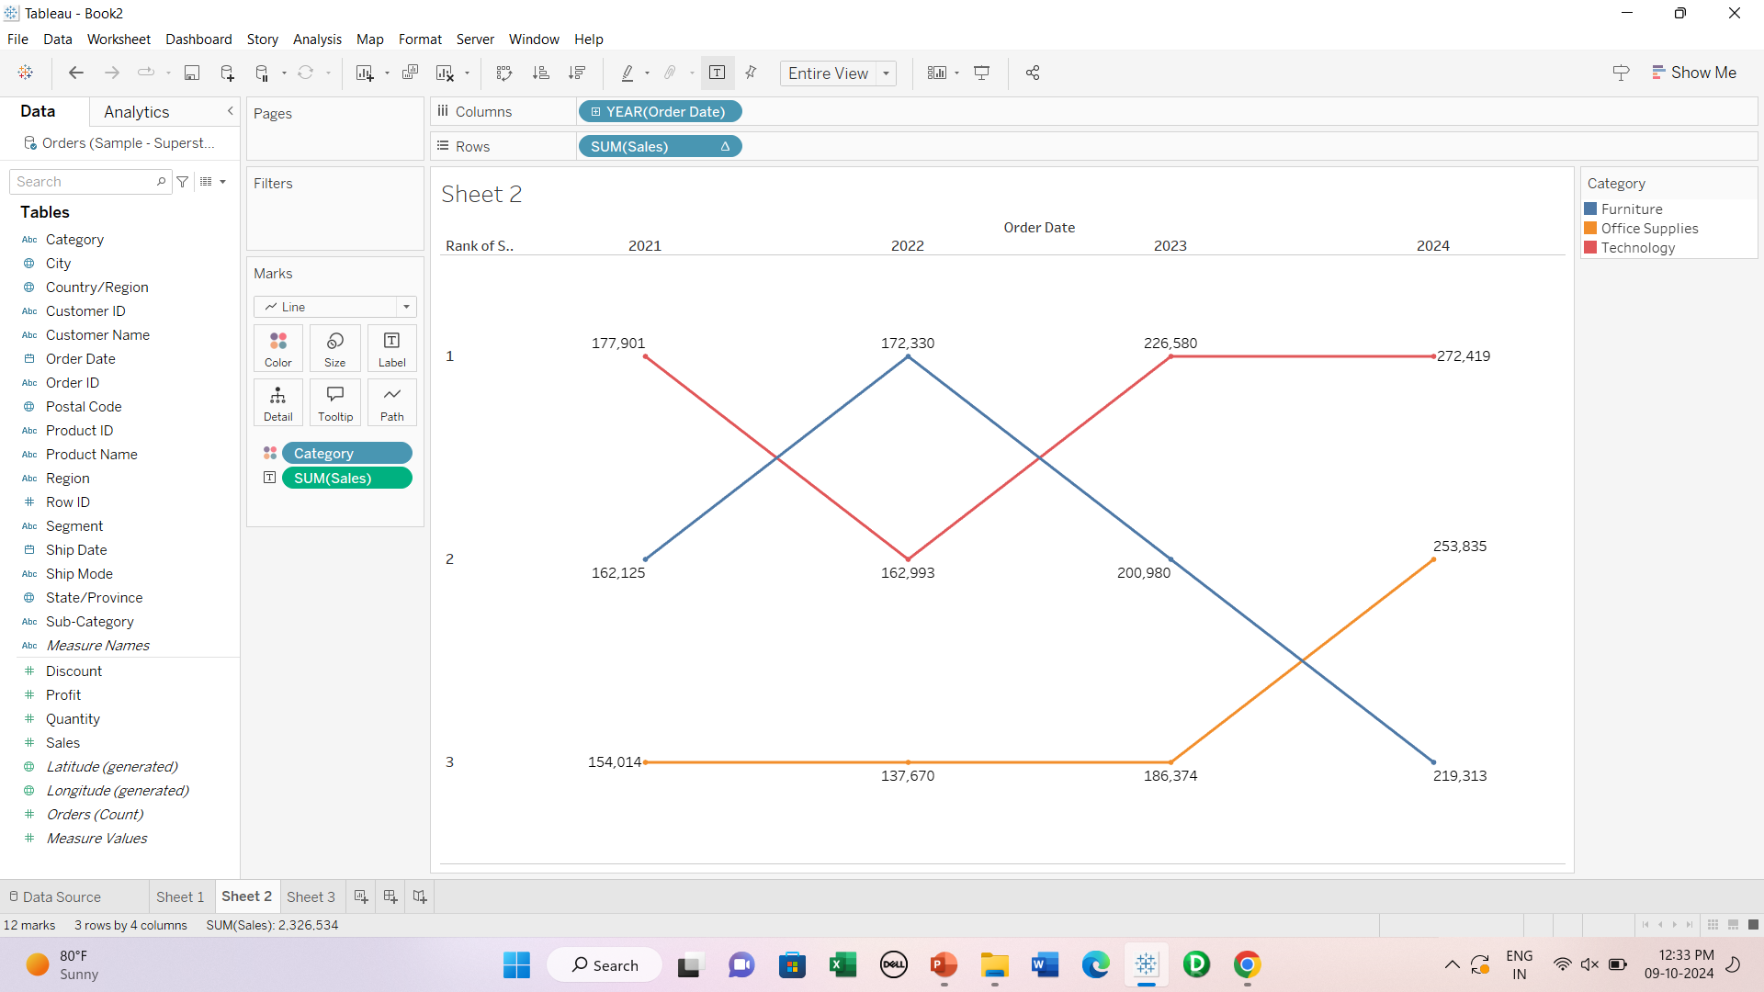

Slide 30
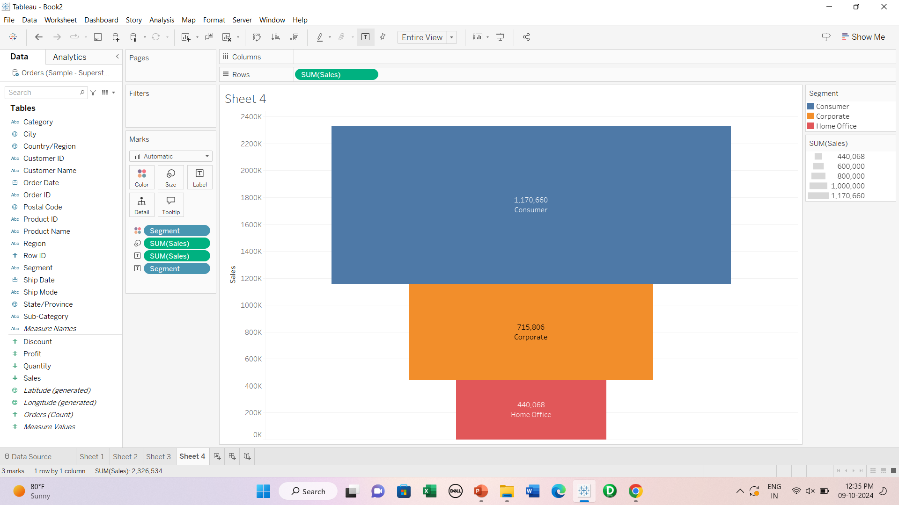
Funnel Chart

Slide 31
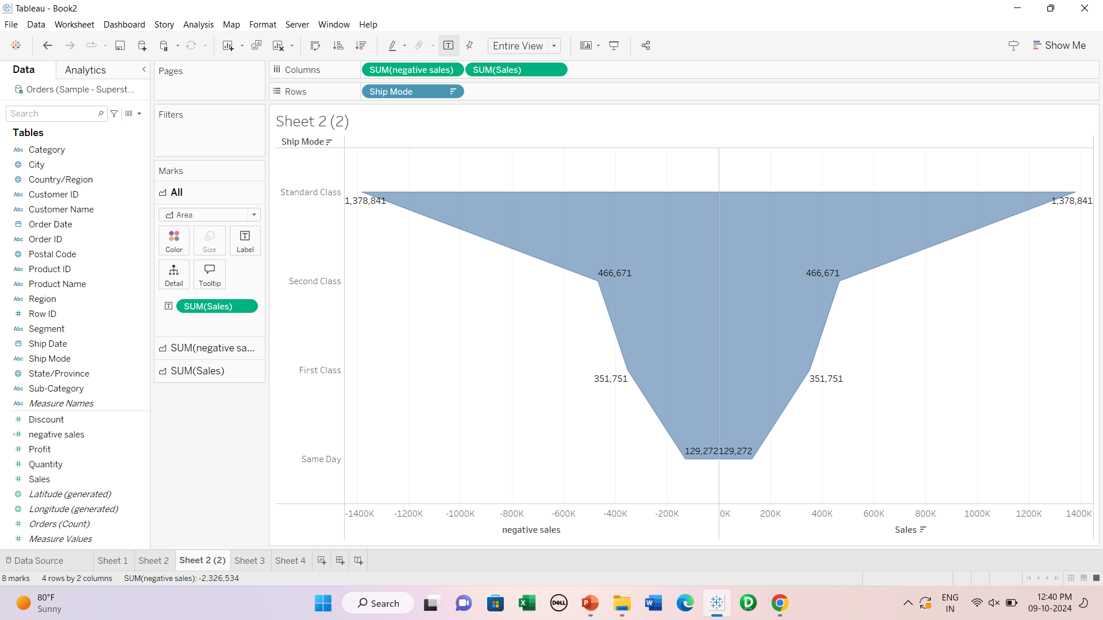

Slide 32
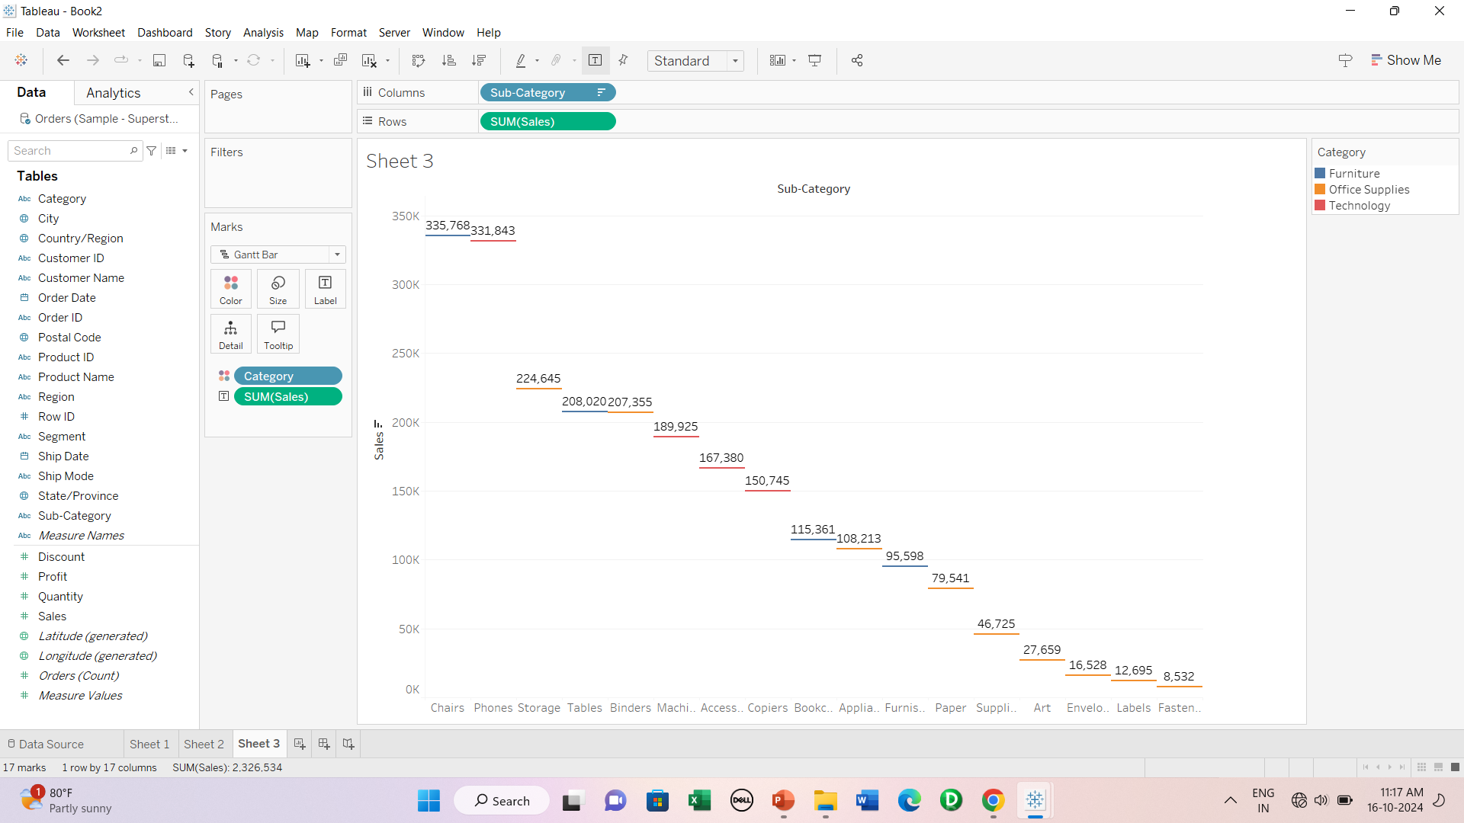
Gantt Bar chart

Slide 33
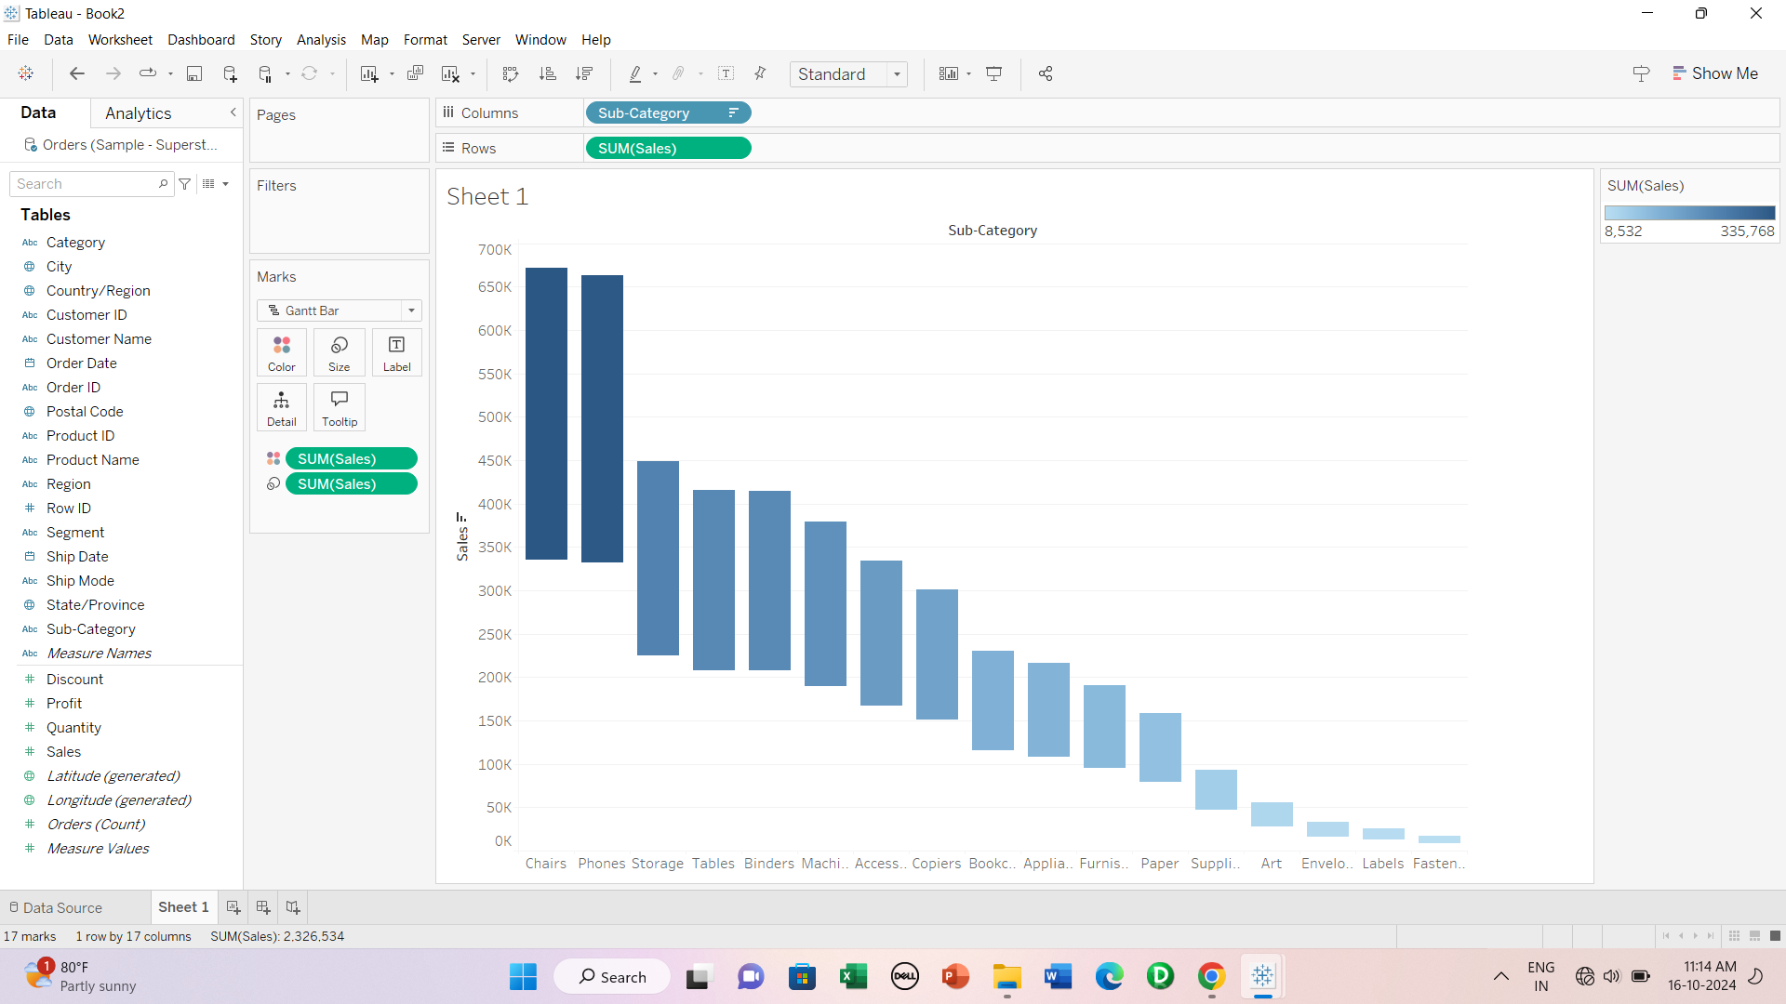
Waterfall chart

Slide 34
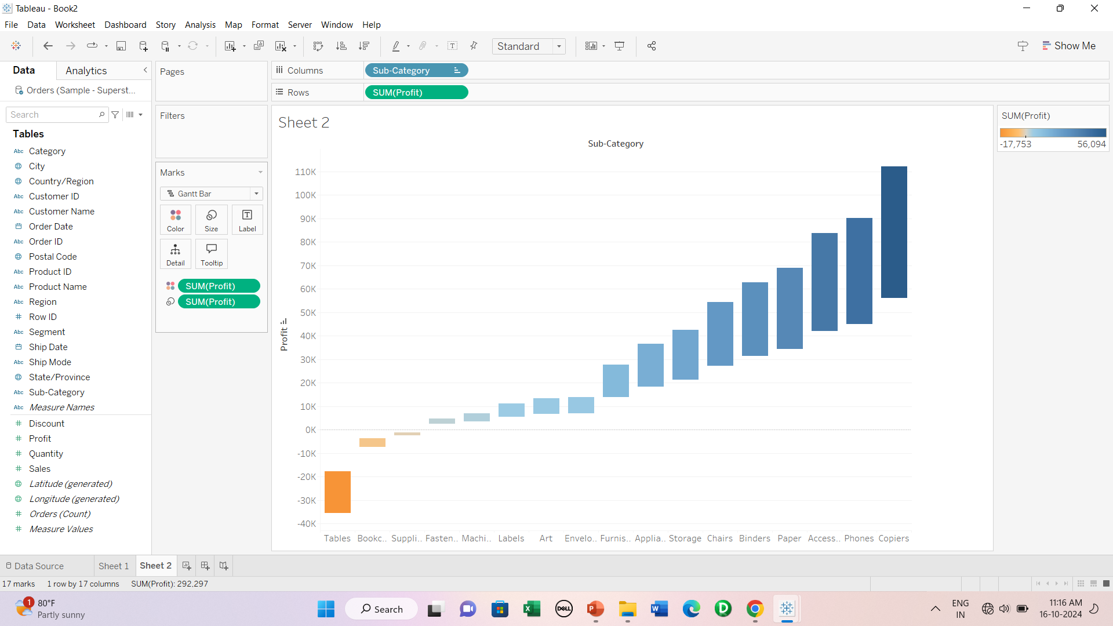

Slide 35
Dual Axis charts
Butterfly
Donut
Pareto

Slide 36
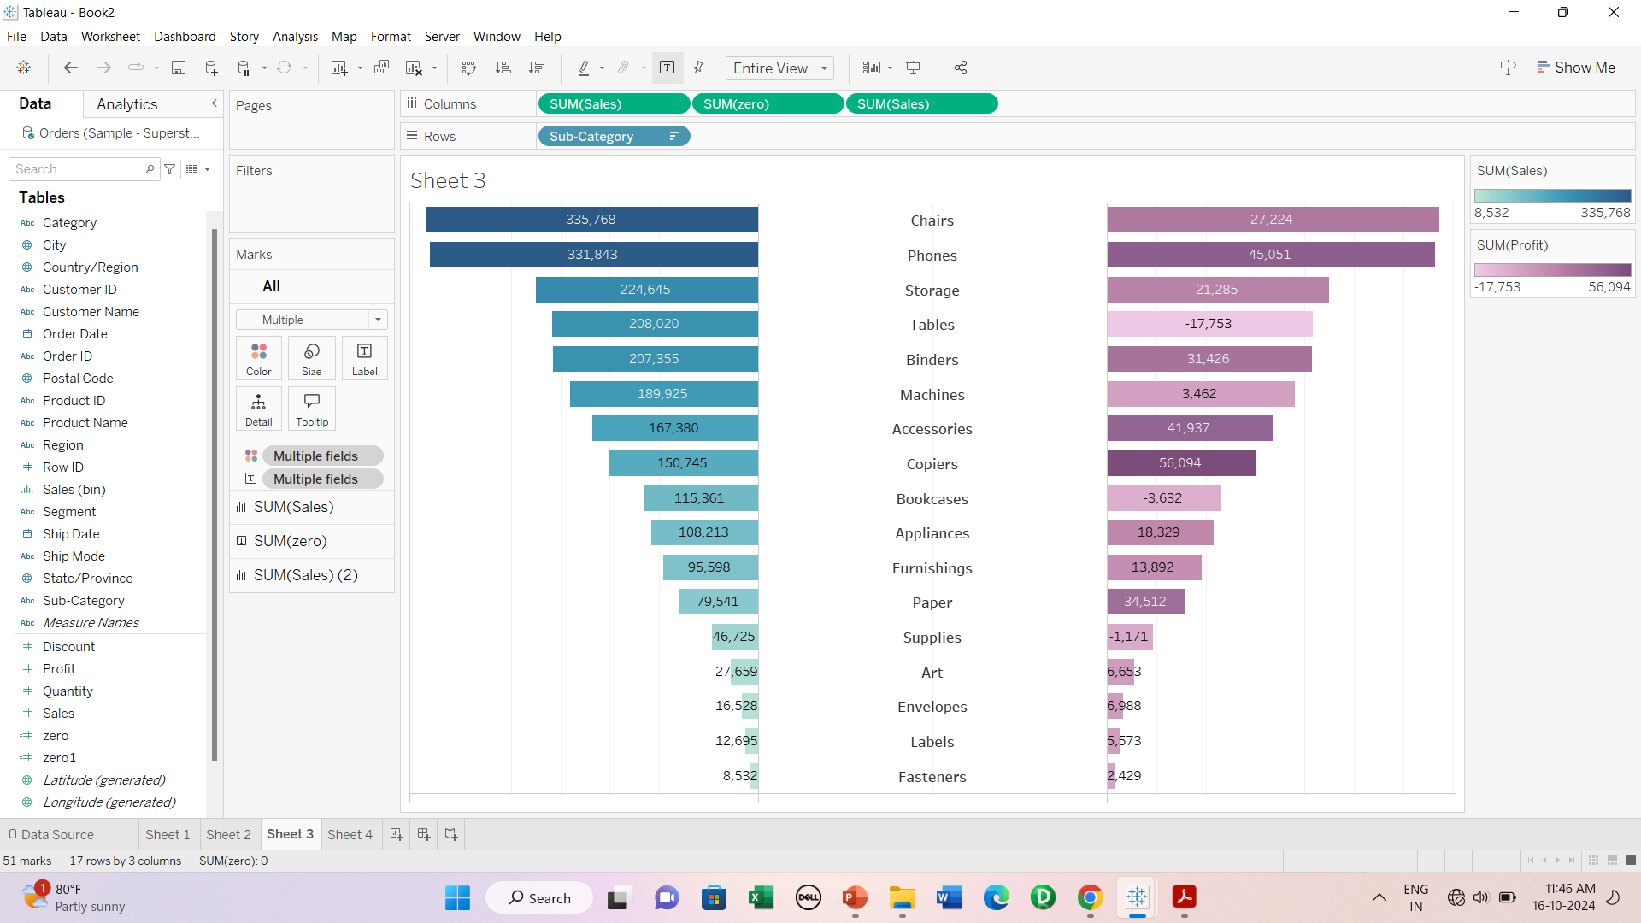
Butterfly Chart

Slide 37
Steps-
1. Plot a horizontal bar chart for subcategory wise sales.
2. Drop sales twice in the shelf
3. For left sales pill, choose reversed scale.
4. Change view to entire view
5.Create a zero calculated field and drop in between 2 sales pills
6. For Sum(zero)
in marks card, add subcategory to labels and change alignment to center.
Go to format-> lines-> change zero lines to none
In Marks card change automatic to text
9. Disable show header for sub category and sales both.
10. For Sum(sales) add sales to label & color.

Slide 38
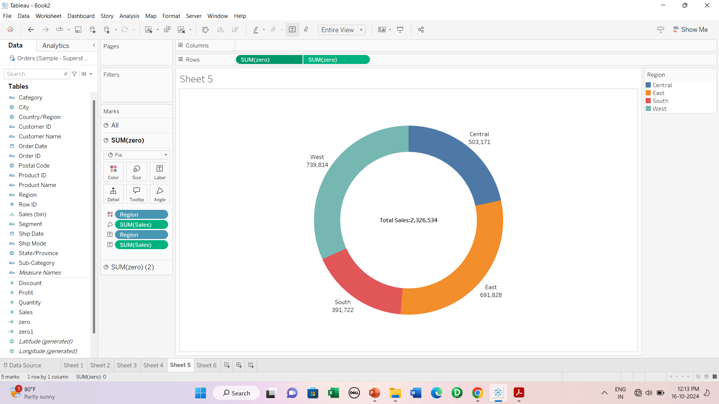
Donut Chart

Slide 39
Steps
1. Create a zero calculated field.
2. Drop Zero into rows shelf.
3. In marks card, convert automatic to pie.
4. Change view to entire view and adjust size.
5. Drop zero field again and drop next to previous zero pill.
6. Choose dual axis for the new zero.
7. Once both pie overlap each other, adjust size and colour of zero2.
8. Add Region to marks card of zero, drop sales to angle and add required labels.
9. For zero2, drop sales into labels to show total sales.
10. Go to format and remove zero lines
11. Disable headers.

Slide 40
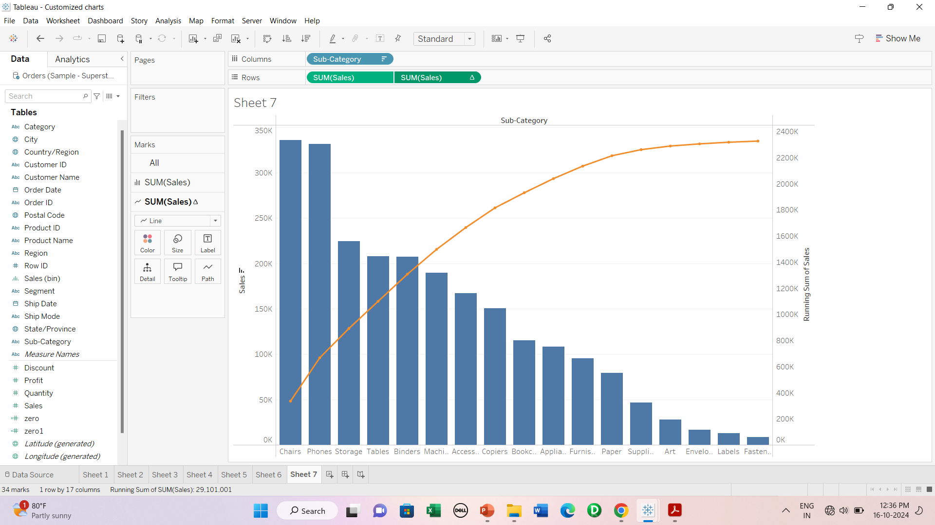
Pareto chart
A combination of Bar chart and Line chart where bars represent individual values whereas line represent cumulative total.

Slide 41
Steps
Plot a chart between subcategory and sales
Sort in descending order
Drop sales again next to previous sales pill
For sum(sales)2, change chart type to line and from pill, choose dual axis.
Convert sum(sales)1 from circles to bar.
For sum(sales)2, go to quick table calculation and choose running total.
Choose different colours for both charts.

Slide 42
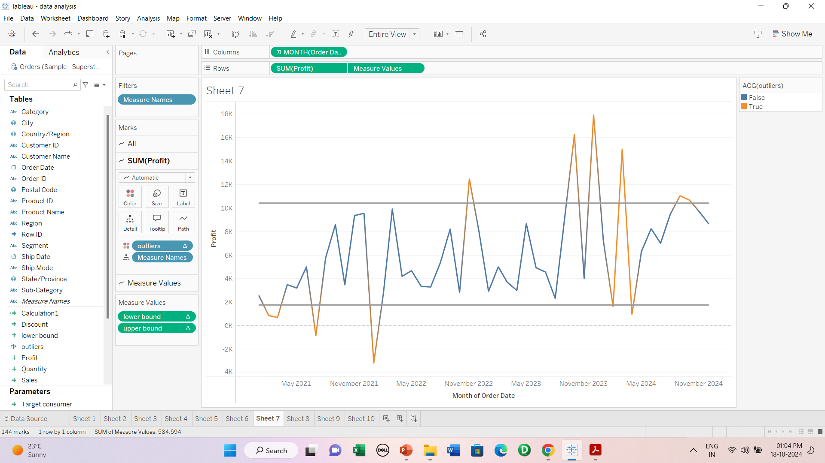
Control chart
A control chart is a line chart that is used to show how data changes over time.
Uses following functions-
WINDOW_AVG()
WINDOW_STDEV()

